Slide 1
Identify abnormal driving behavior using spatio-temporal analysis
CSE 523 Machine Learning
Guided by: Prof. Mehul Raval
Group - 11 Titans

Slide 2
Team Members
Enrollment Number | Name
AU2140043 | Bhavya Khakhar
AU2140154 | Harsh Loriya
AU2140170 | Krishna Patel
AU2140187 | Priyam Shah

Slide 3
Project Overview
Our project is critical for ensuring the road safety and improving traffic system that improves the intelligent transportation System.
The Main Goal of our project is to develop an binary classifier which predicts normal or abnormal driving behaviour for certain trajectory of road using spatio temporal features.
These spatio temporal features includes top, width, height, left, latitude and longitude data points, we have extracted in necessary features in the process of Data cleaning.
Our study has been done on the frames of video dataset that were taken by drone.
Notes:
ITS: - It helps identify bottlenecks, congestion hotspots, and areas prone to traffic accidents.
By addressing these issues through infrastructure improvements or traffic management strategies, transportation authorities can optimize traffic flow, reduce congestion, and improve overall efficiency of the transportation network.

Slide 4
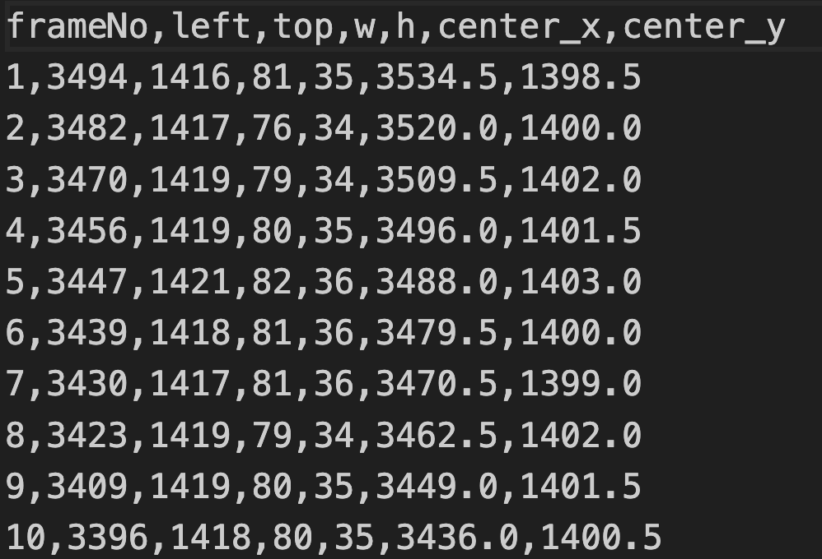
Dataset

Slide 5
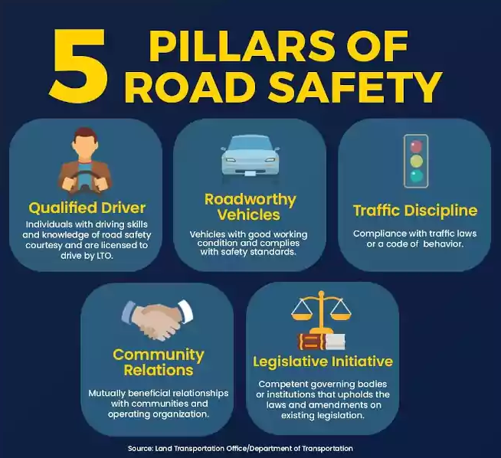
Importance of Research
Safety Concerns.
Legal and Regulatory Compliance.
Intelligent Transportation System.
Driver health and well being.
Accident prone areas detection.
Cooperativas Micoope. (2022, September 20). Inicio - Micoope. Micoope. https://www.micoope.com.gt/?o=road-safety-united-nations-nn-dJxewQfp
Notes:
ITS: - It helps identify bottlenecks, congestion hotspots, and areas prone to traffic accidents.
By addressing these issues through infrastructure improvements or traffic management strategies, transportation authorities can optimize traffic flow, reduce congestion, and improve overall efficiency of the transportation network.

Slide 6
Methodology
Data cleaning: Identifying and removing the null values and unnecessary columns
File rename/arrangement: Renaming the file names such that it consist labels in it.
Calculating centroids of the Bounding Box: Calculating the centroid on the basis of left-top, width, and height to get better understanding of the data.
Training and testing of the model: Random Forest algorithm was used for the classification of normal/abnormal driving behaviour.
Result analysis and reasoning: Accuracy we got is 82%.

Slide 7
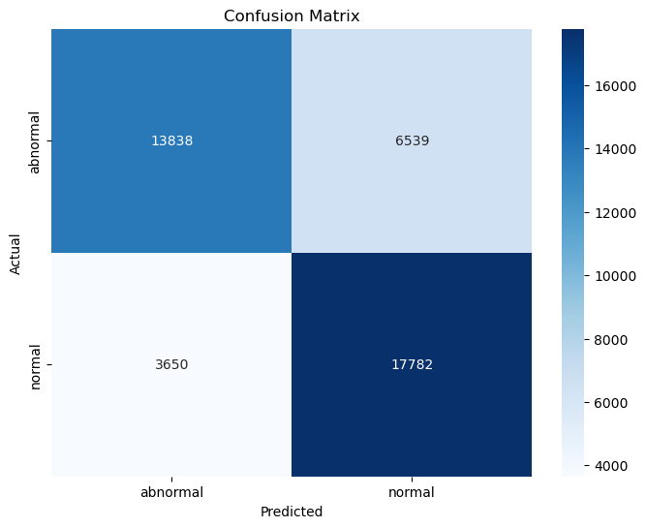
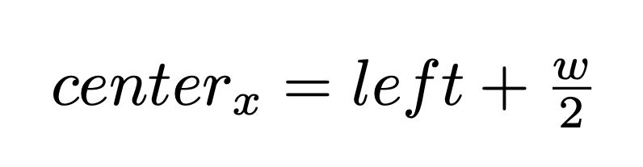
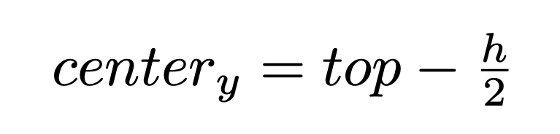
Result Discussion(1/4)
F1 Score: 0.7544
Accuracy : 78%

Slide 8
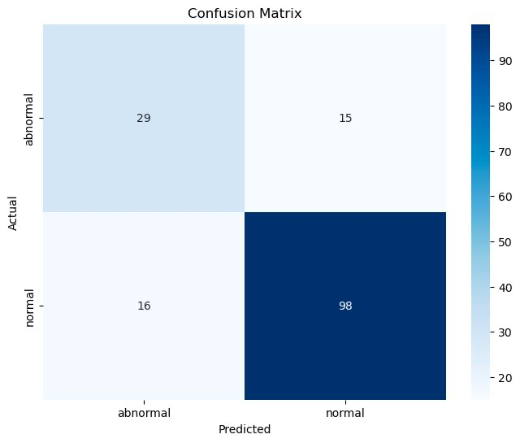
Result Discussion(2/4)
F1 score: 0.7575
Accuracy: 82%

Slide 9
Result Discussion(3/4)
Insufficient Data
Overspeeding for shorter duration
Slight change in lane
Disobeying traffic rules
Half Normal/Half Abnormal driving behaviour

Slide 10
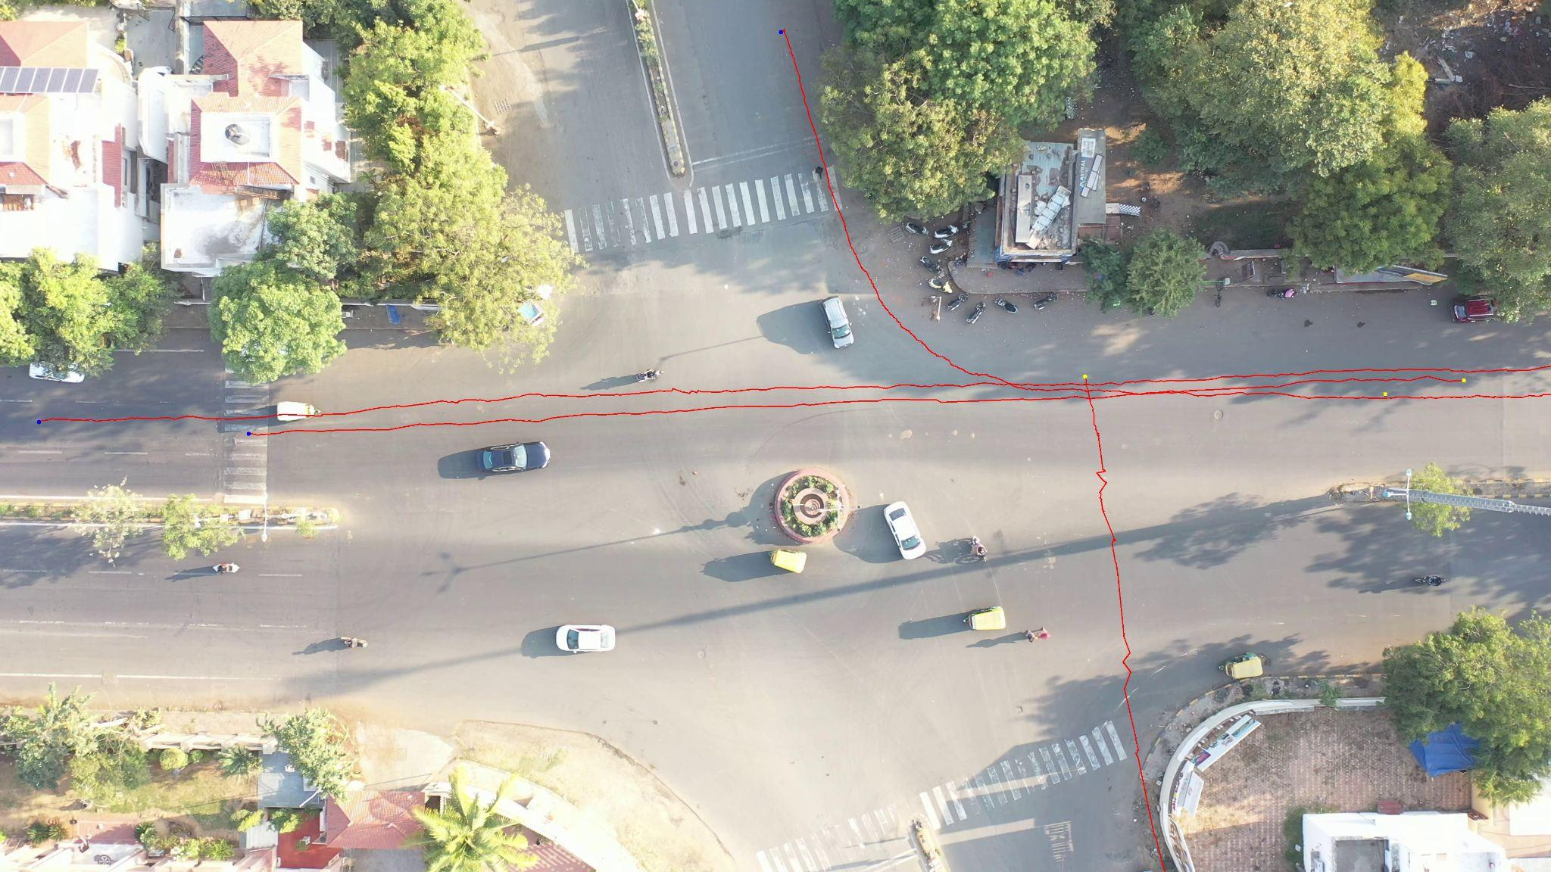
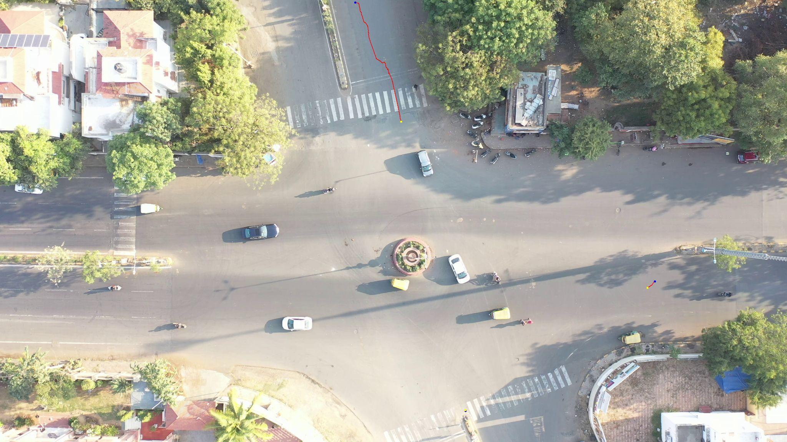
Result Discussion(4/4)
Abnormal
Normal

Slide 11
References
Yagnik M Bhavsar, Mazad S Zaveri, Mehul S Raval, Shaheriar B Zaveri, “Vision-based investigation of road traffic and violations at urban roundabout in India using UAV video: A case study,” Transportation Engineering, vol.14,p.100207,2023.Available: https://doi.org/10.1016/j.treng.2023.100207
Yu Zhang, Yingying He, and Likai Zhang, "Recognition method of abnormal driving behavior using the bidirectional gated recurrent unit and convolutional neural network,'' Physica A: Statistical Mechanics and its Applications, 2022. Available: https://doi.org/10.1016/j.physa.2022.128317
geeksforgeeks GeeksforGeeks, ``Confusion Matrix in Machine Learning, ”GeeksforGeeks, Available: https://www.geeksforgeeks.org/confusion-matrix-machine-learning
Xiaodi Huang et al., ``Abnormal driving behavior detection based on an improved ant colony algorithm,'' Applied Artificial Intelligence, 2023. Available: https://doi.org/10.1080/08839514.2023.2216060
Yongfeng Ma et al., ``Real-time detection of abnormal driving behavior based on long short-term memory network and regression residuals,'' Transportation Research Part C: Emerging Technologies}, 2022. Available: https://doi.org/10.1016/j.trc.2022.103983
Cooperativas Micoope. (2022, September 20). Inicio - Micoope. Micoope. https://www.micoope.com.gt/?o=road-safety-united-nations-nn-dJxewQfp

Slide 12
Thank You.

